Slide 1

Team Members:
Amarnadh Reddy Mettu(am14305)
Jeel Patel(jjp9182)
Unmesh Achar(ua2150)
CS-GY 6513 : Big Data, Section C, Fall 2024

Slide 2


NYC CRIME AND ROUTE PREDICTION

Slide 3

Project Statement

Slide 4

Brief Abstract
The NYC Risk & Route Prediction system is an innovative tool designed to enhance urban safety and navigation using advanced data-driven methods. The project integrates predictive modeling, geographic data, and crime statistics to create a web-based platform that enables users to make informed decisions about their movements within New York City. By leveraging zone-specific crime risk data and real-time geolocation services through the Google Maps API, the application predicts the likelihood of crime at user-specified locations and evaluates the safety of walking routes between two addresses.
This solution addresses a critical urban challenge: navigating safely in a densely populated area with varying crime rates. By combining crime prediction models and geospatial analysis, the project empowers users with actionable insights to avoid high-risk areas, fostering greater confidence and safety in their daily lives.

Slide 5
Objective

Slide 6

Primary Objective:
To create a predictive system that delivers both crime risk assessment and risk-aware route suggestions in NYC, ensuring safer navigation for users
Risk Prediction:
Predict the crime risk percentage for any user-provided location based on its geographic coordinates.
Identify and rank the top 3 most likely crime types at that location, along with their probabilities.
Route Prediction:
Analyse multiple walking routes between a source and destination.
Calculate a risk score for each route by aggregating the crime risk data of the zones traversed.
Provide route recommendations based on risk score, total distance, and estimated travel time.

Slide 7
Broad Vision:
This project aims to serve as a prototype for similar systems that can be applied to other urban areas worldwide, contributing to smarter, safer cities through data-driven technology.
User Experience:
Develop a user-friendly web interface where users can interactively input locations and retrieve results in real-time.
Present results in an intuitive manner, including percentages, scores, and clear step-by-step navigation instructions.
Technological Innovation:
Utilise machine learning models for accurate crime predictions.
Integrate the Google Maps Geocoding and Directions APIs to provide precise geolocation and routing functionalities.
Leverage modern tools like Streamlit for rapid prototyping and deployment.

Slide 8
Data Source
GITHUB REPOSITORY LINK
DRIVE LINK FOR THE PROCESSED DATASET

Slide 9
Tech Stack
Data Preparation and Processing
Python 3: The primary programming language used for developing the project. Python's extensive libraries and frameworks provide flexibility for data manipulation, machine learning, and visualization.
Joblib: Used for saving and loading large Python objects, especially in the context of machine learning and data science workflows.
NumPy: Used for numerical operations, such as managing large datasets, creating multi-dimensional arrays, and performing matrix operations.
Pandas: Used for cleaning, transforming, and preparing structured datasets (e.g., the zone risk data).
PySpark: Integrated for distributed computing when handling large datasets. Ensures scalability and efficient data processing in a clustered environment.
Folium: Used for creating interactive maps for visualizing geospatial data and plotting data points on maps.
Scikit-learn: Employed for implementing machine learning algorithms for crime risk prediction. It was used to train, evaluate, and deploy predictive models.
Dask: A parallel computing library to scale data processing tasks and enable operations on larger-than-memory datasets.

Slide 10
Visualisation
Matplotlib: A comprehensive plotting library used to create static, interactive, and animated visualizations.
Seaborn: Built on Matplotlib, it was used for creating aesthetically pleasing and informative statistical graphics, such as heatmaps and distribution plots.
Tableau: A powerful data visualization tool for creating dynamic dashboards and presentations. It was leveraged for analyzing trends and demonstrating results effectively to stakeholders.

Slide 11
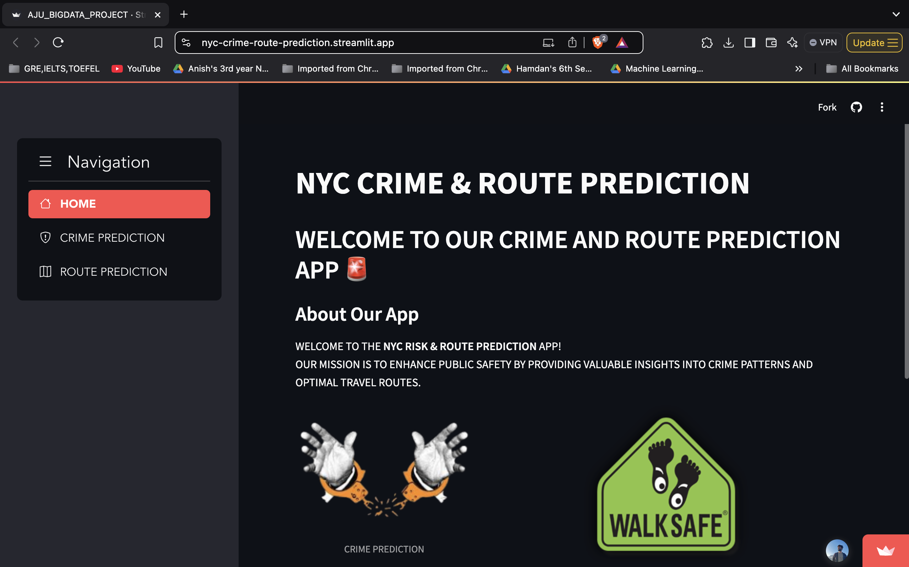
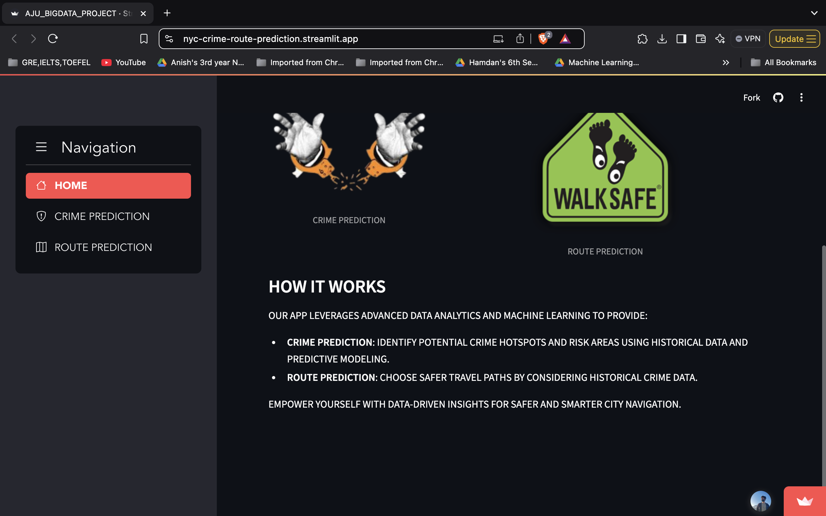
Results

Slide 12
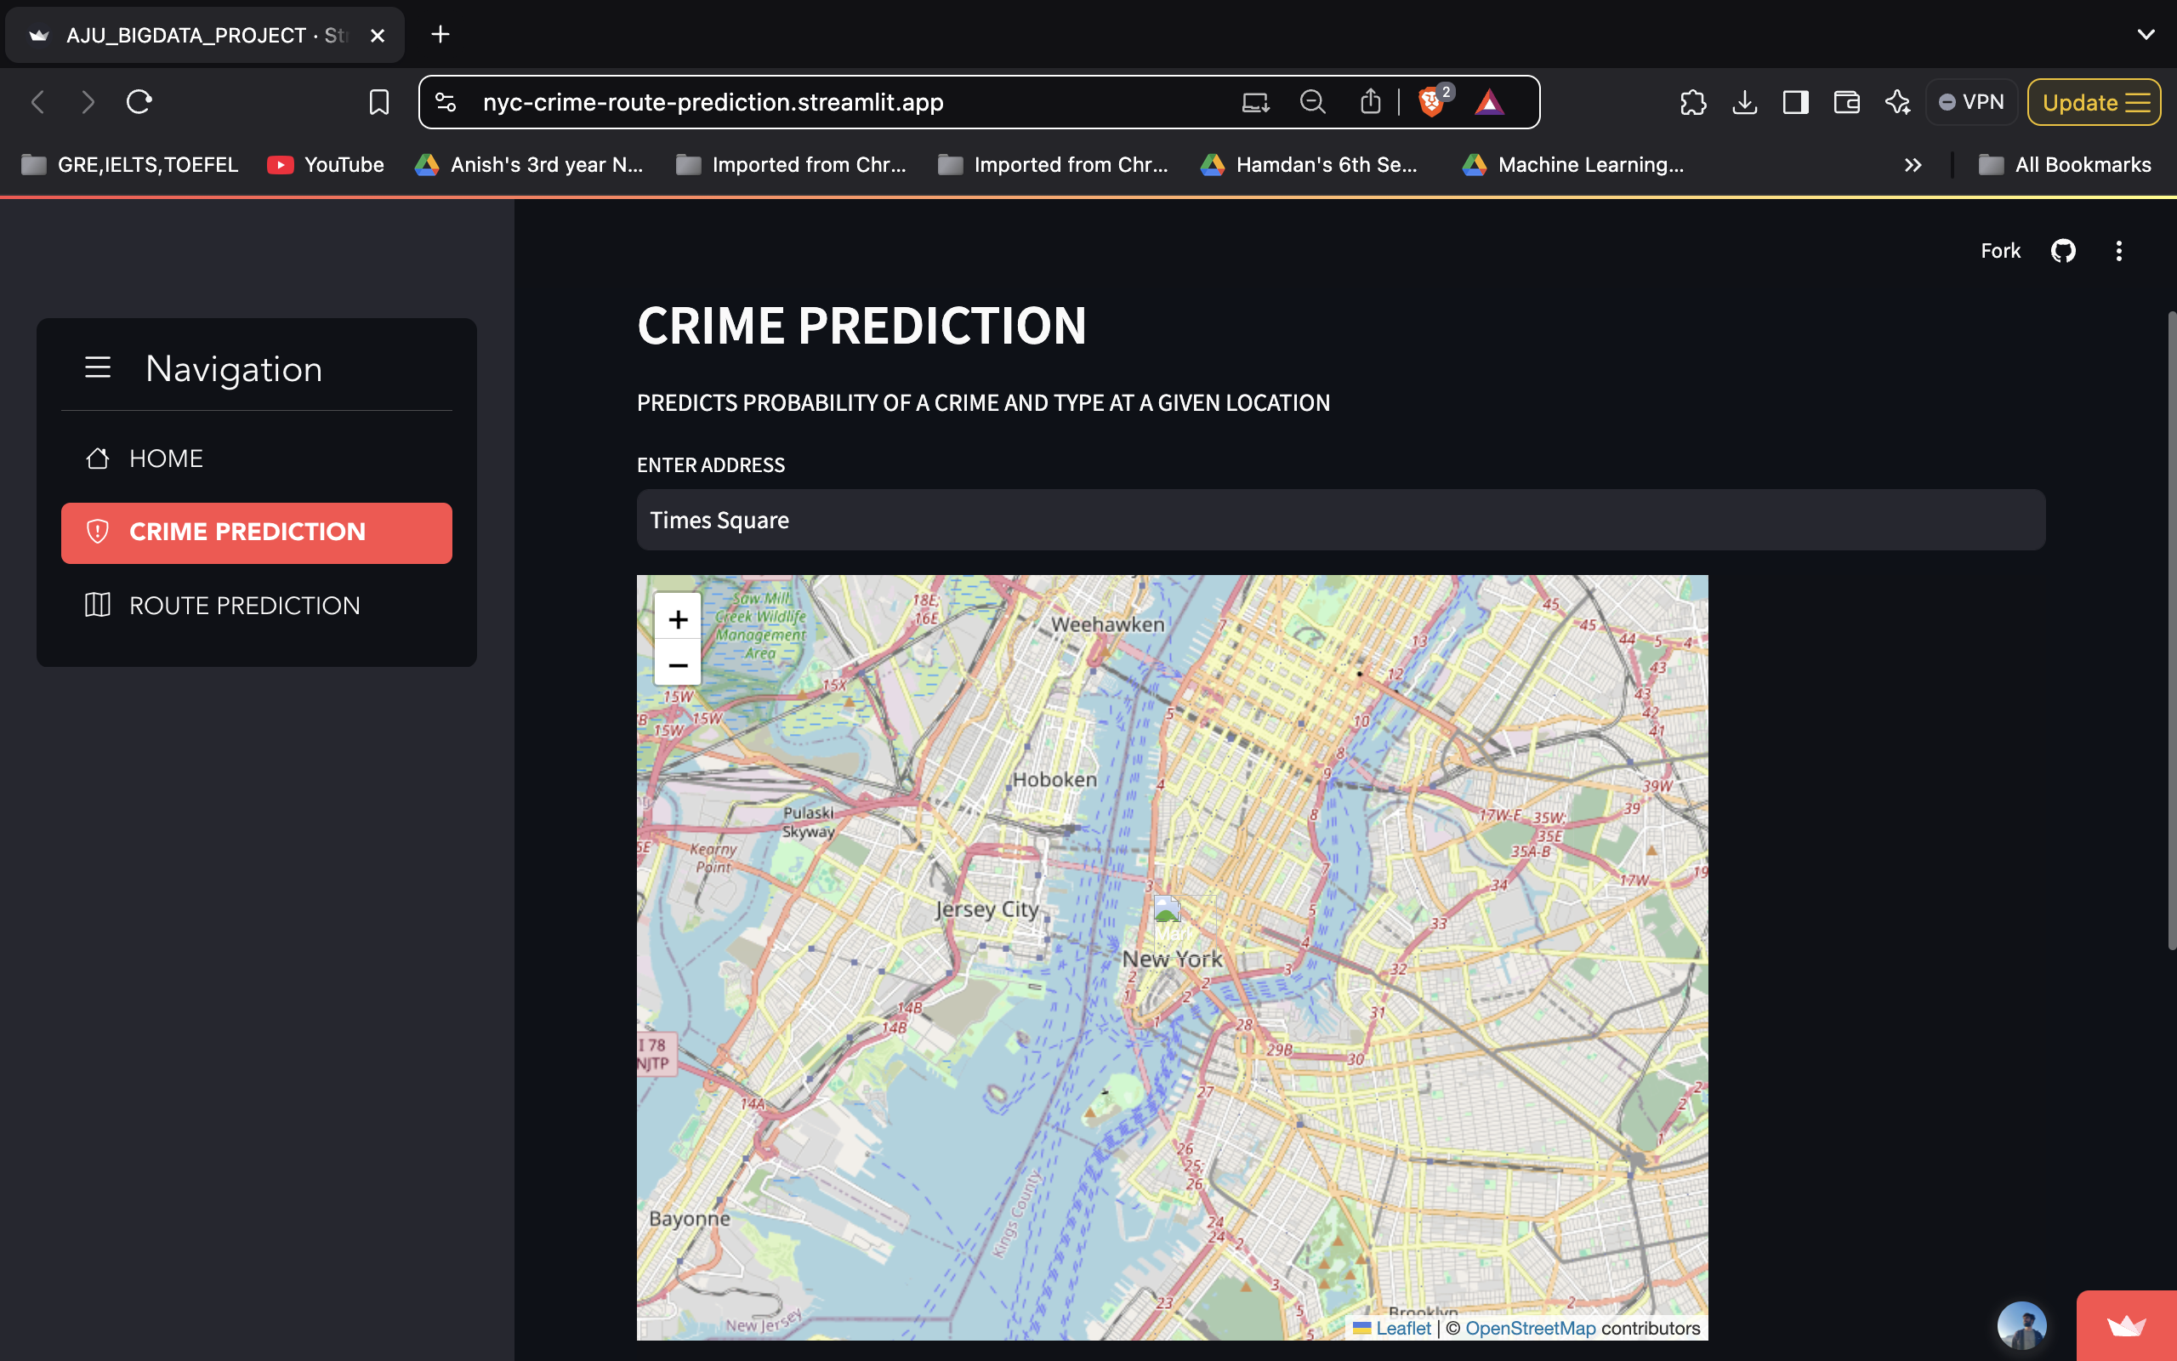
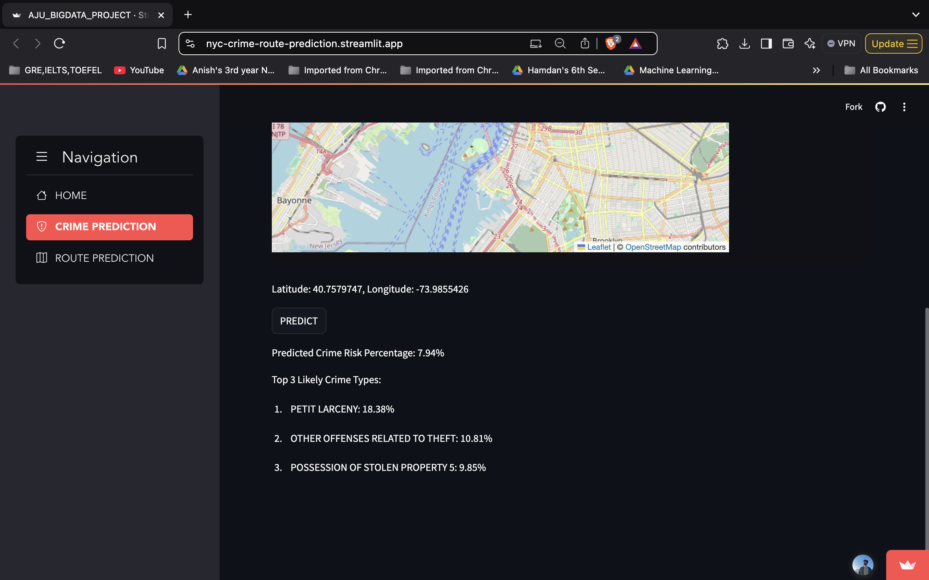
Crime Prediction

Slide 13
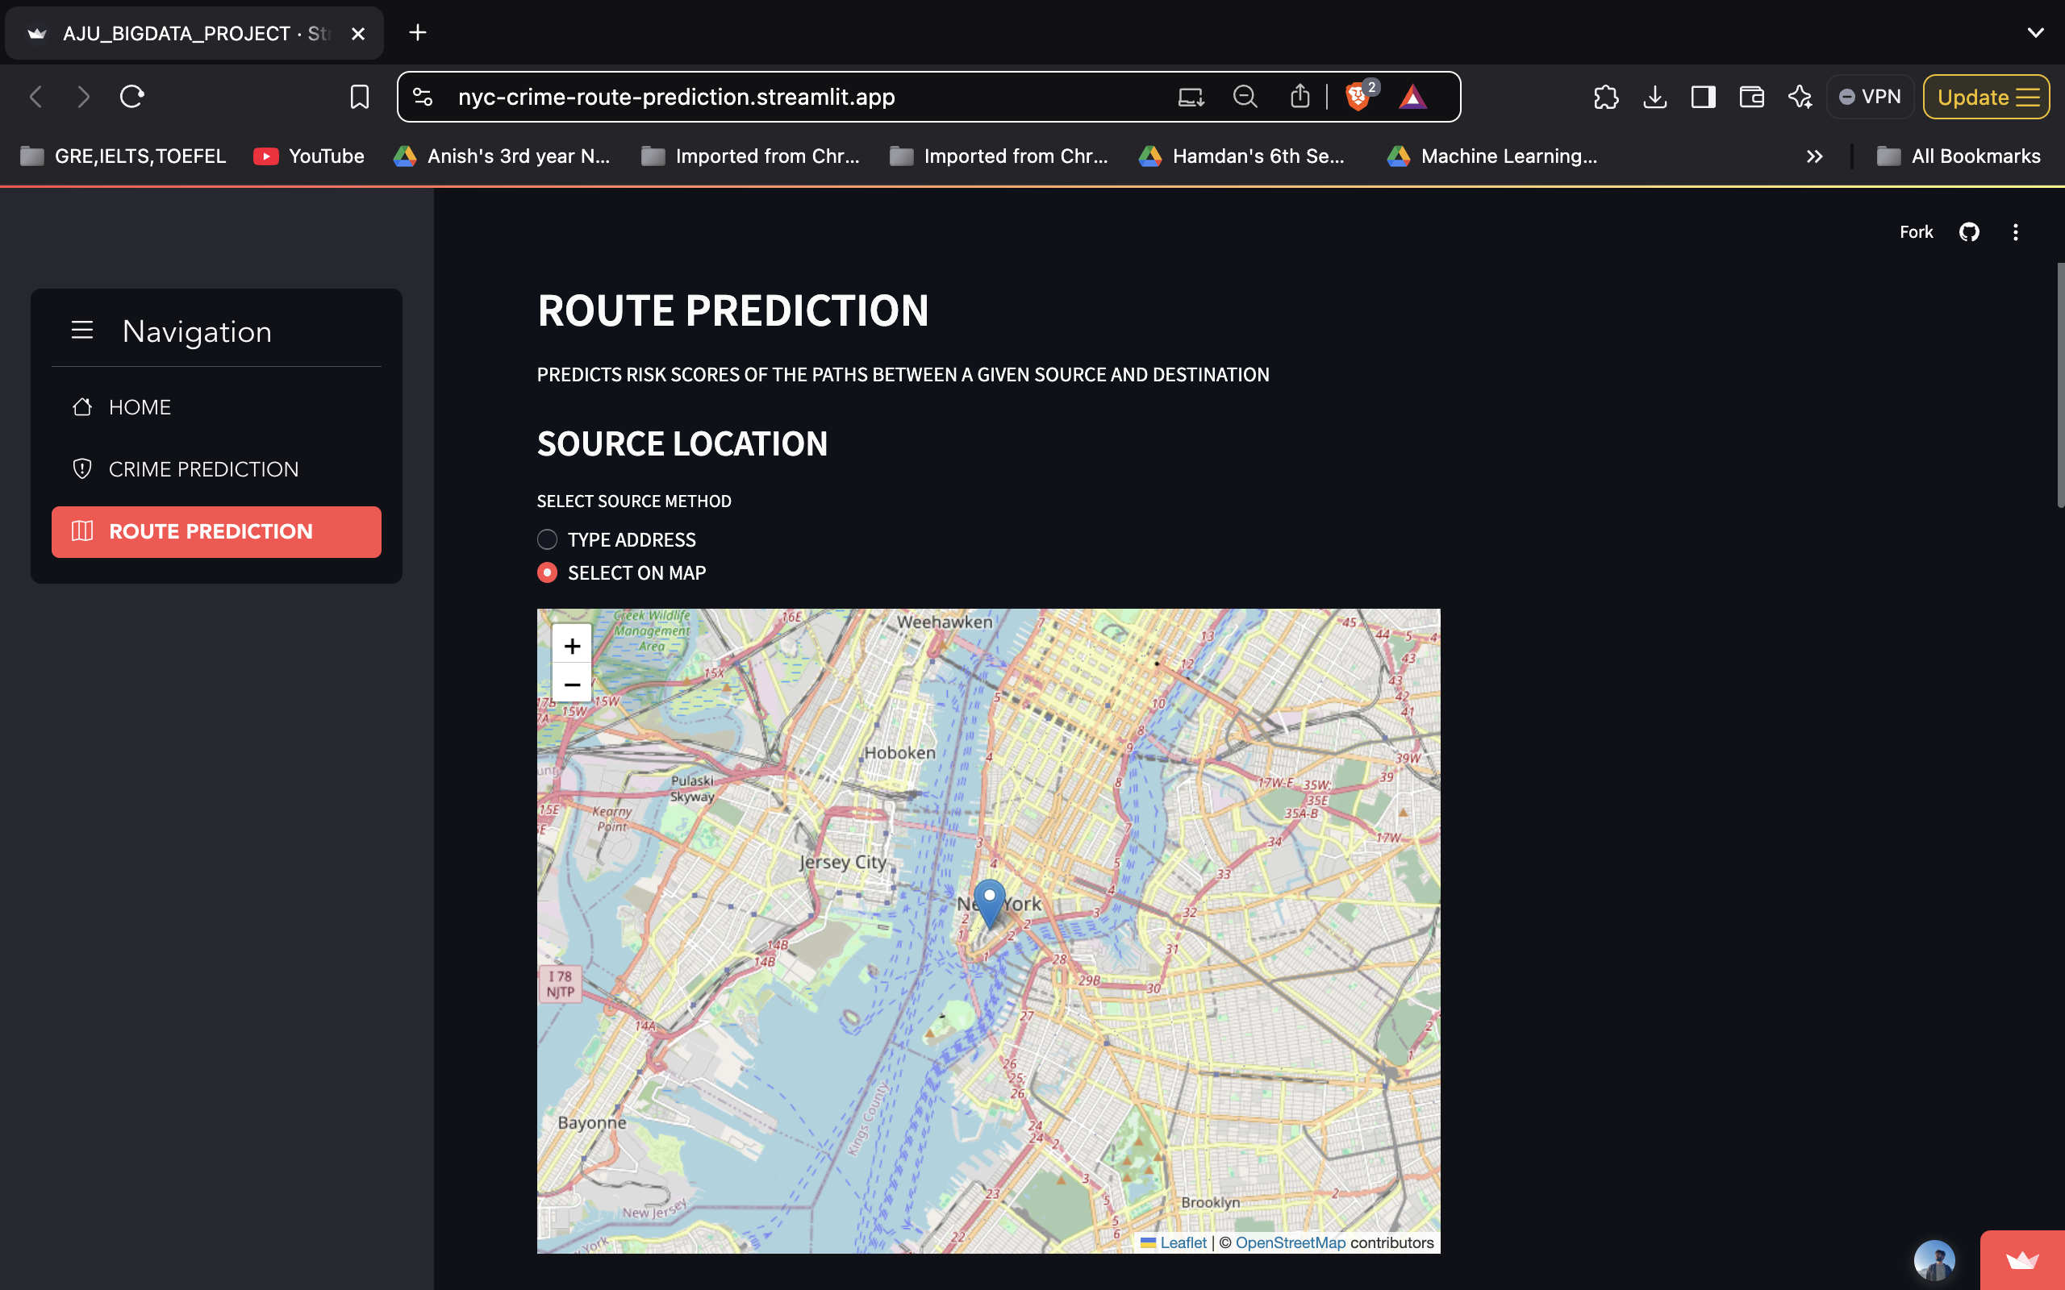
Route Prediction
Source Location

Slide 14
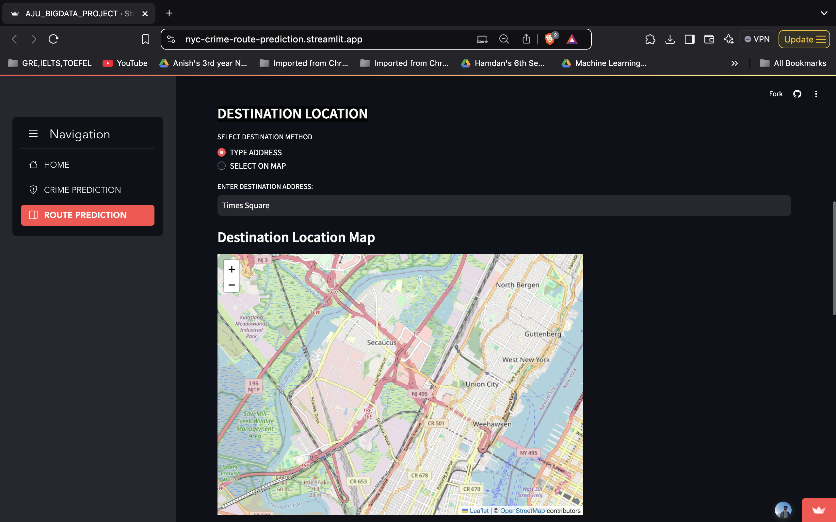
Destination Location

Slide 15
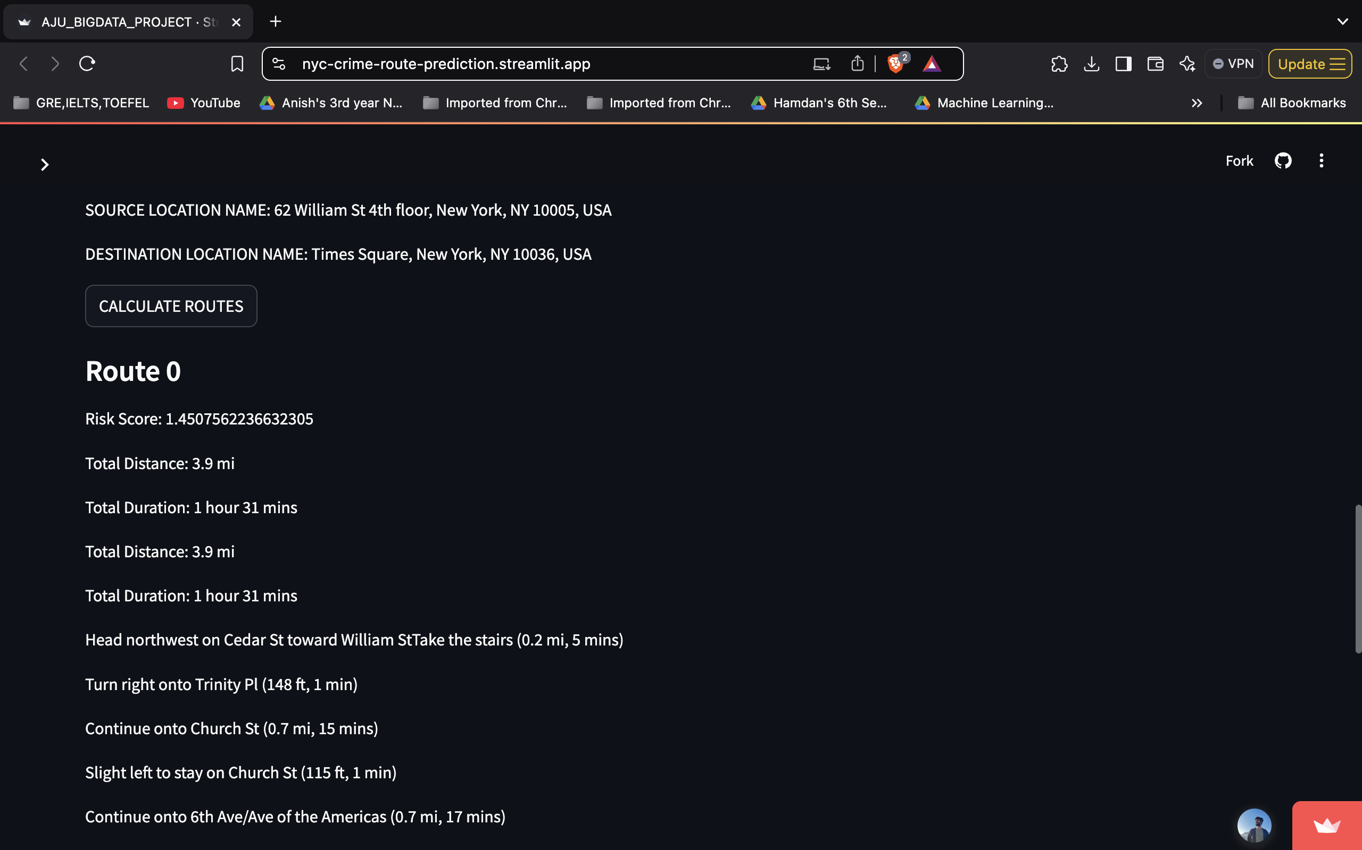
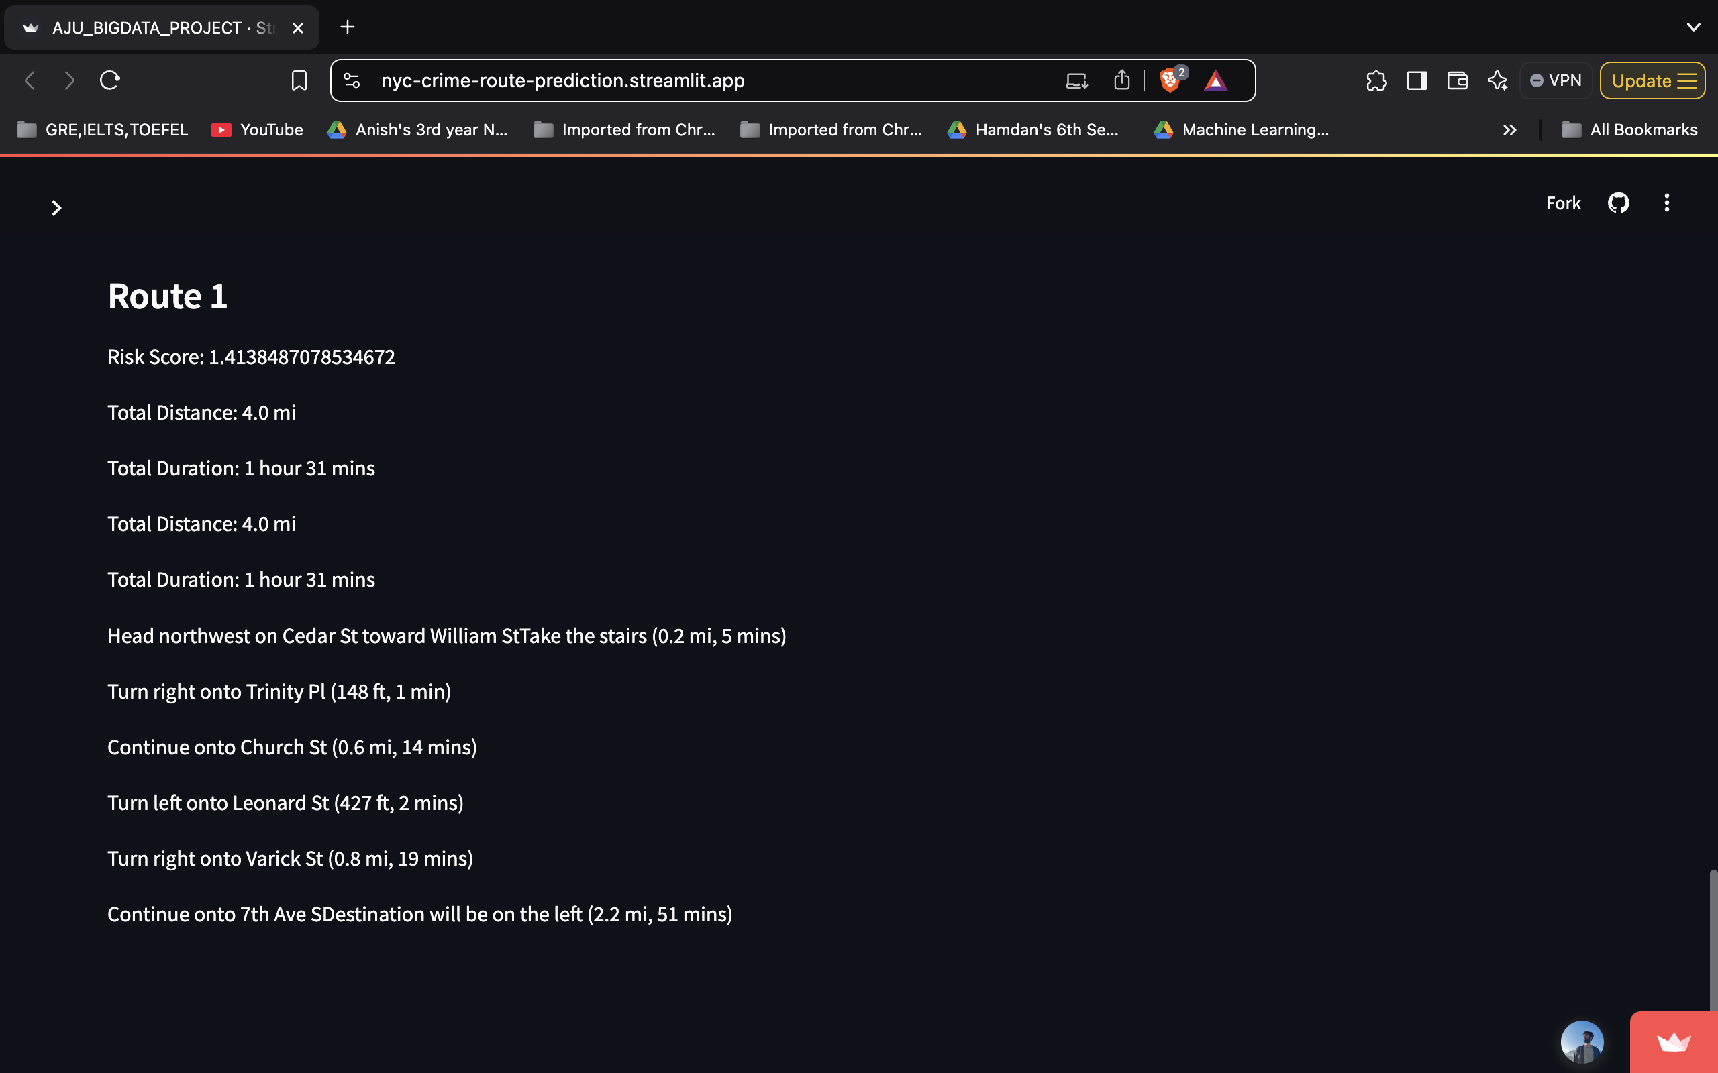
Route Prediction(of different routes)

Slide 16
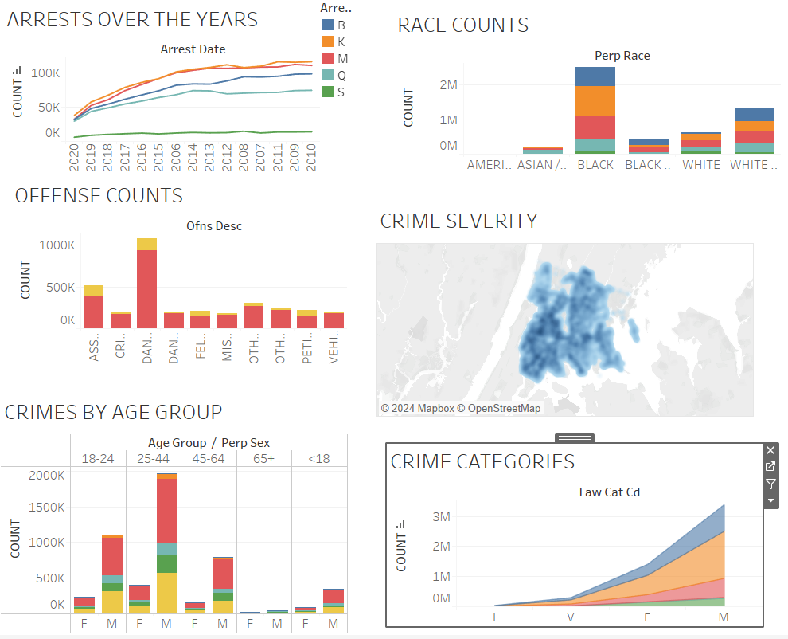
TABLEAU DASHBOARD

Slide 17
Conclusion and Lessons Learned
Conclusion:
Successfully integrates crime risk prediction and route safety analysis into a single system.
Provides valuable insights for users navigating NYC, helping them avoid high-risk areas.
Combines modern machine learning with real-world geospatial data to enhance usability.

Slide 18
Learned Learned
Data Challenges:
Handling missing or inconsistent zone risk data required robust preprocessing.
Google Maps API integration required careful error handling to deal with rate limits and incomplete responses.
System Design:
Breaking down the problem into modular components (risk prediction, route analysis) made development more manageable.
3.Technology Insights:
Streamlit proved to be an excellent tool for creating quick, interactive web applications.
Learned the importance of efficient caching for large data and models using Streamlit and Joblib.

Slide 19
Future Scope:
Extend functionality to include real-time crime updates.
Extend route analysis to consider multiple transportation modes (e.g., cycling, driving).
Incorporate user feedback to refine prediction models and improve accuracy.

Slide 20

Thank You

